Slide 1
DESIGN PATTERN - DEPENDENCY INJECTION
Replace easily
PRESENTATION BY
JATIN DAVE

Slide 2
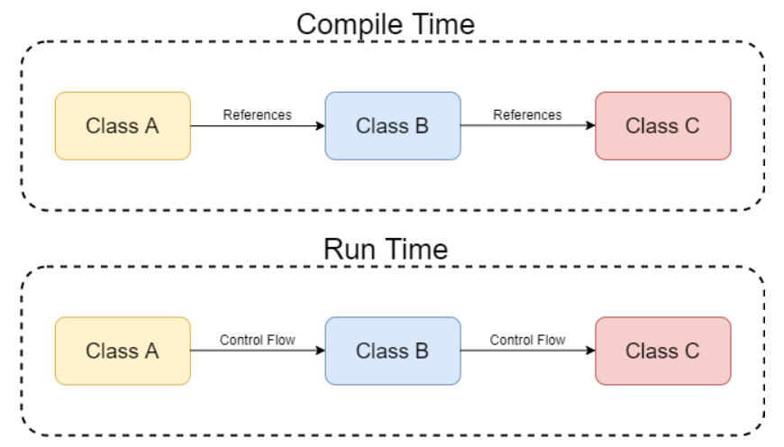
WHAT IS DEPENDENCY IN CODE?
Basic Term: Something that is dependent on something else.
A piece of code relies on another piece of code, then we call it dependency.
Direct Dependency:
Class B Depends on Class A : Class A is referencing a method from Class B
Class C Depends on Class B : Class B is referencing the method from Class C
Indirect Dependency:
Class C Depends on Class A : Class A is referencing the method from Class B which further referencing a method from Class C.

Slide 3

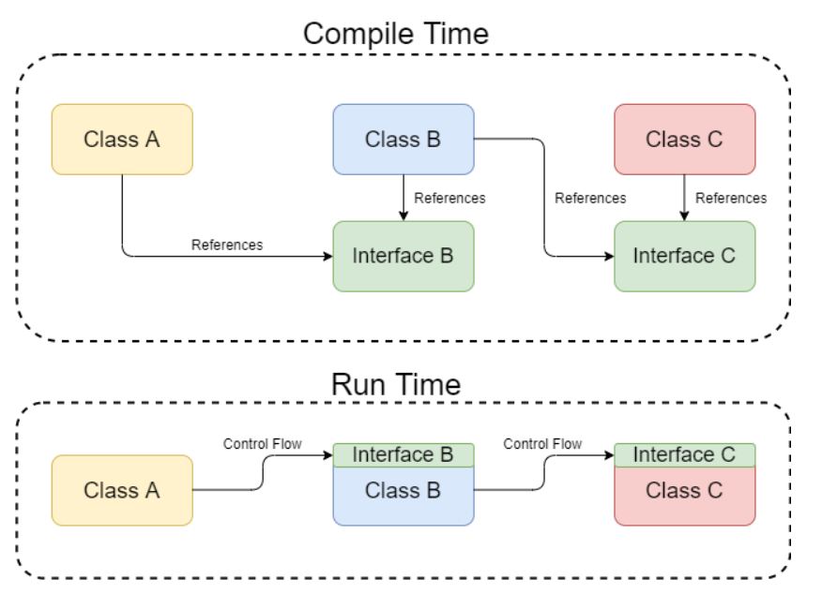

DEPENDENCY INJECTION - DEFINITION
Dependency injection is a software design pattern that allows a choice of component to be made at run-time rather than compile time
What Mark Seeman says: Dependency Injection is a set of software design principles and patterns that enable us to develop loosely coupled code.
Purpose of DI: Make code maintainable.
Using Abstraction: Class A calls a method from an abstraction – Interface B that Class B implements. Class B calls a method from an Interface C instead of Class C directly.
Loosely coupled: Class B is no longer a dependency of Class A, and Class A and Class B remain loosely coupled.
Dependency Inversion: Class B depends on the interface controlled by Class A and therefore the compile-time dependencies are inverted

Slide 4
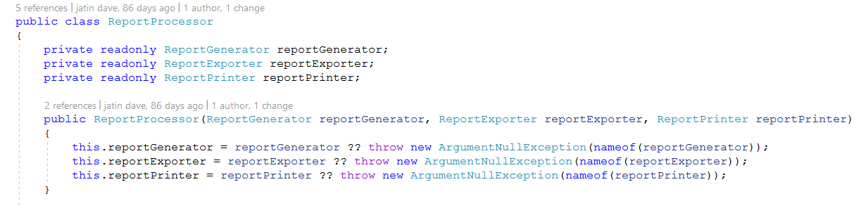
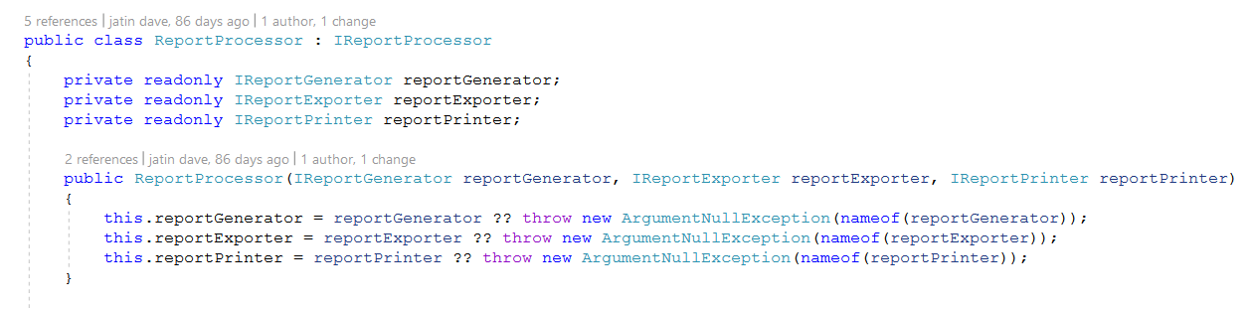
DEPENDENCY INJECTION - EXAMPLE

Slide 5
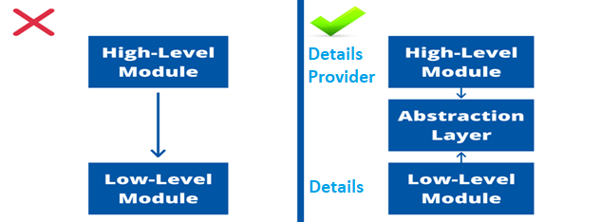
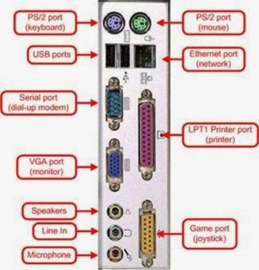
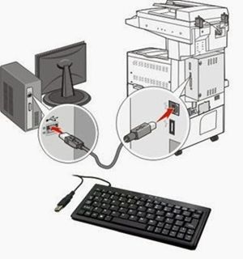
REVISIT -DEPENDENCY INVERSION PRINCIPLE
High-level modules should not depend on low level modules and vice versa, both should depend upon abstraction.
Abstractions should not depend upon details. Details should depend upon abstractions.
Low-level : It contains the details.
Hight-Level: Provider of details. (The code is dealing with policies, business rules and the bigger picture).
Problem: Change in a low-level module affects implementation of higher modules.
Solution : They should depend on abstraction. No tight coupling should be among components (Viz. modules, classes) of software.

Slide 6
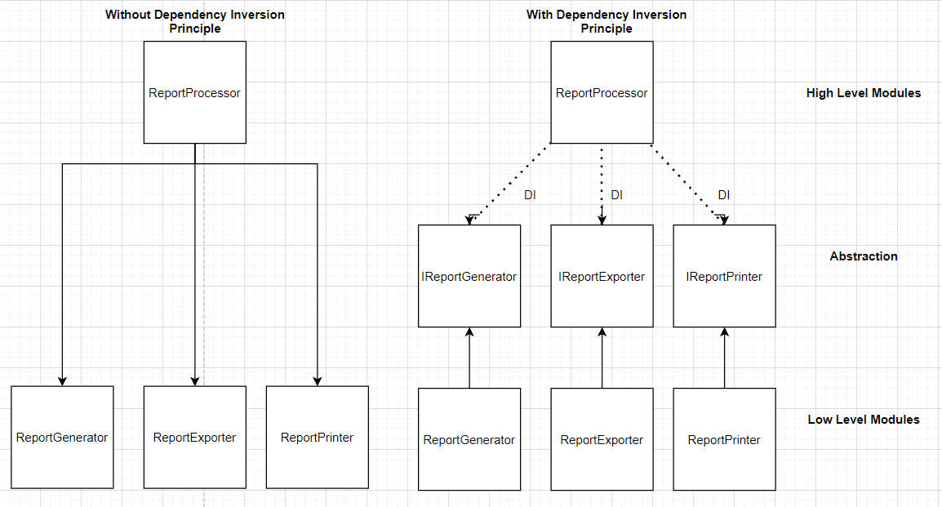
REVISIT -DEPENDENCY INVERSION PRINCIPLE

Slide 7

DEMO
Ye ab bakwas chalu karega

Slide 8
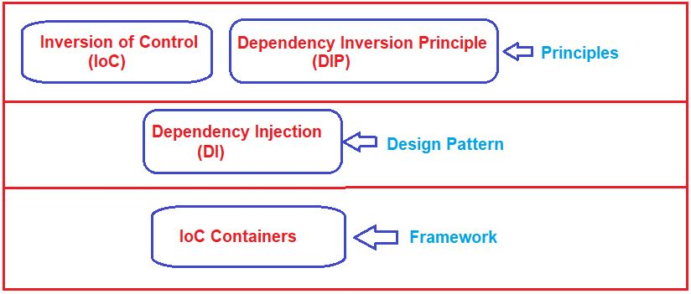
INVERSION OF CONTROL(IoC) Principle
Objective:
Principle suggests the inversion of various types of controls in object-oriented design to achieve loose coupling between the application classes.
Here, the control means any extra responsibilities a class has other than its main or fundamental responsibility. For example, control over the flow of an application, control over the dependent object creation
Benefit:
Decouple components of an application.

Slide 9
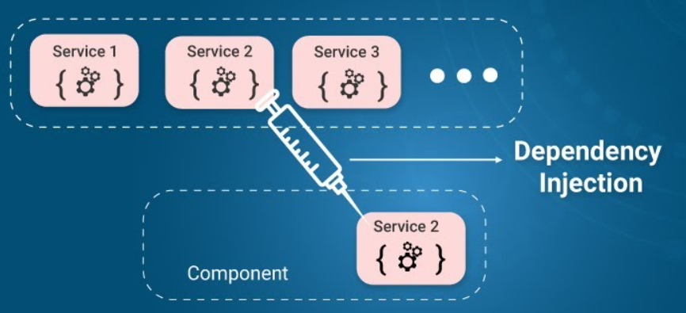
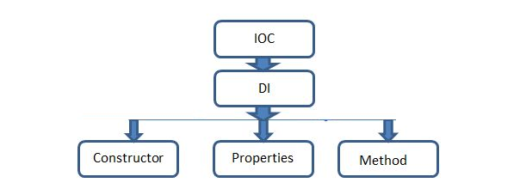
DEPENDENCY INJECTION
Types of Dependency Injection:
Constructor Injection
Property/Setter Injection
Method Injection
Benefit:
Reduces class coupling.
Increases code reusability.
Improves code maintainability
Make unit testing possible.

Slide 10

DEMO
I also inject colleague who
do my work

Slide 11
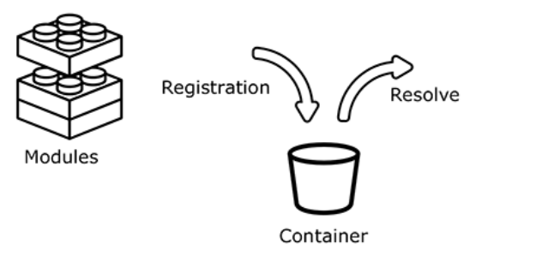
IoC Containers
Definition:
The IoC Container is a framework to create dependencies and inject them automatically whenever required throughout the application.
Automatically creates necessary objects base on request and injects whenever required of dependencies.
Benefit:
Save time and effort creating dependencies.
Manage lifetime and scope of newly created object.
Example:
Unity , Autofac, Ninject, StructureMap

Slide 12
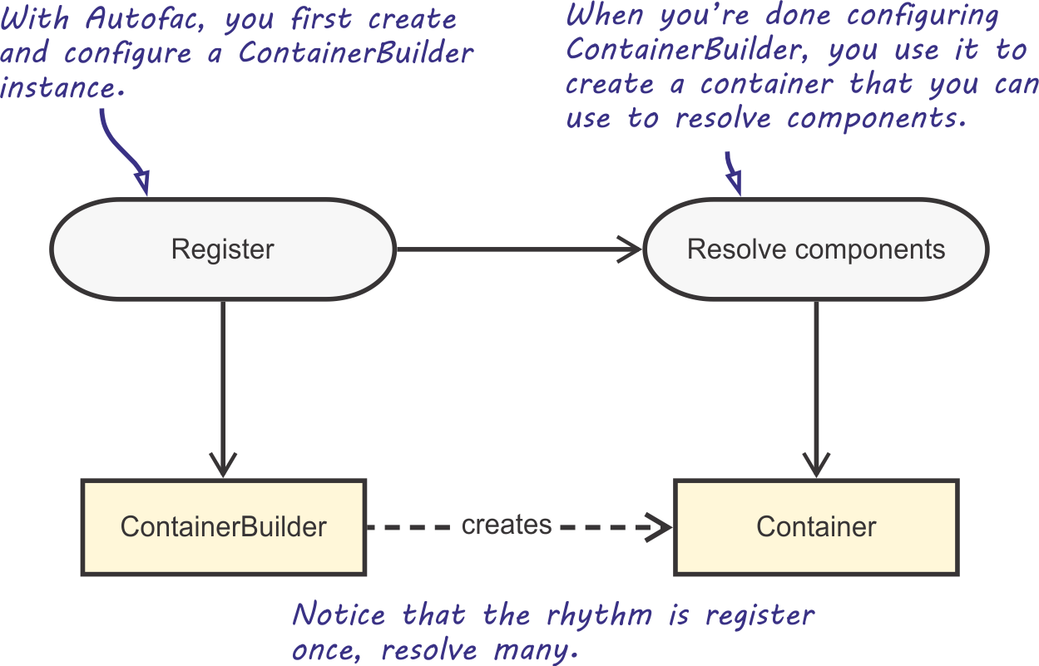
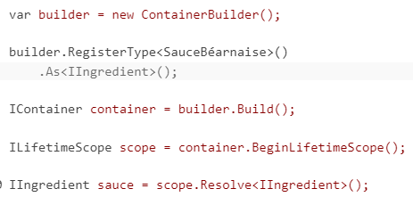
DI Container - Autofac
DI Container
Autofac is widely used DI container for .Net Framework application.
Two step process:
Register
Resolve Components

Slide 13
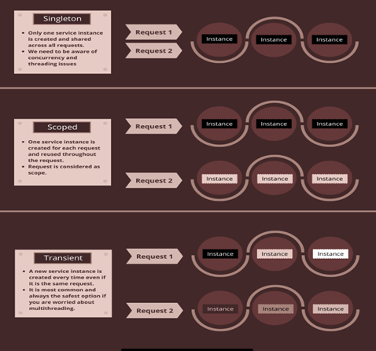
DI Container
Service Registration Lifetimes:
three different registration lifetimes we can choose from when registering our services
Transient – Each time the service is called, the new instance is created. We can use this for lightweight, stateless services.
Scoped – The instance of the service is created once per request and within that request (scope) it is reused
Singleton – The instance is created only once in lifetime of App

Slide 14
DEMO
Is this Automation?

Slide 15


Any Questions?
Github Code Link

